Slide 1
Information
Easy Read information
for sexual / violent offenders

Slide 2
Contents
Who is this information for…………….…..…….3
What agencies work together……………...…..4
The risk assessment process……………….…....5
What the risk assessment means………….…..6
Designated risk managers……………….….….….7
Working with the agencies………………….…....8
Things you have to tell the police…………...…9
Your first registration with the police……….10
What changes the police need to know…..11
Indefinite notifications…………………………….12
Further information…………………………….…..13

Slide 3
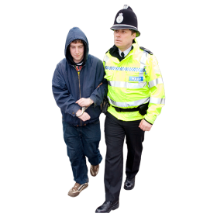
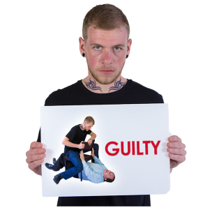
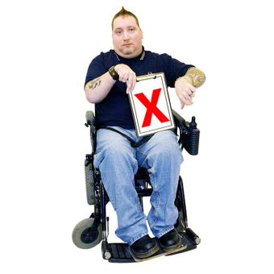
Find out more information
Who is this information for
This information is for people who have been convicted of a sexual or violent offence.
Convicted means that a court has found you guilty. You may have been found unfit to take part in the court process.
This information is also for people who have been cautioned for a sexual or violent offence.
Cautioned means that you’ve done something wrong or the police have evidence that you’ve done something wrong.
When you get a caution, you could go to court if you break the rules.

Slide 4
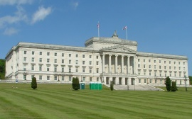
What agencies work together
The following agencies work together to keep you and the public safe. All agencies may not be needed.
Police Service of Northern Ireland
Probation Board for Northern Ireland
Northern Ireland Prison Service
Health and Social Care Trusts
Northern Ireland Housing Executive
Child protection agencies
Other relevant Government Departments

Slide 5
The risk assessment process
Your risk of re-offending will be assessed.
A Category 1 is classed as a low risk.
A Category 2 is classed as a medium risk.
A Category 3 is classed as a high risk.

Slide 6
What the risk assessment means
If you are category 1 low risk, you will see the police at least once a year. You can contact in the mean time if needed.
If you are a category 2 medium or category 3 high risk, you will be reviewed by the agencies every 16 weeks.
The agencies will decide if a person’s risk has changed.

Slide 7
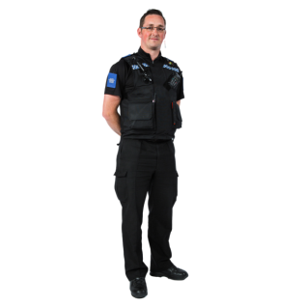
Designated Risk Managers
Offenders who are category 2 or category 3 will have a Designated Risk Manager.
A Designated Risk Manager is your main contact person.
A Designated Risk Manager is usually from the police or probation.
A Designated Risk Manager is sometimes from a Healthcare Trust.

Slide 8
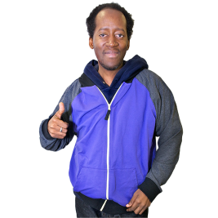
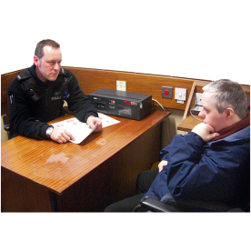
Working with the agencies
It is very important for you to work with the agencies.
You will be able to be involved in decisions.
Working with the agencies may help reduce the risk of re-offending.
It is serious if you do not work with the agencies.
If you do not work with the agencies, the police will monitor you more closely.

Slide 9
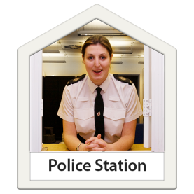
Things you have to tell the police
A notification requirement is a set of rules you have to follow from the law.
If you have been convicted or cautioned of a sexual offence, you have to tell the police information.
You have to tell the police within 3 days of release from prison, after court, or if anything changes.
You have to go to a police station to talk to the police.

Slide 10
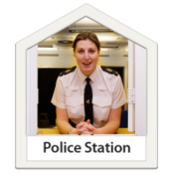
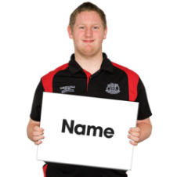
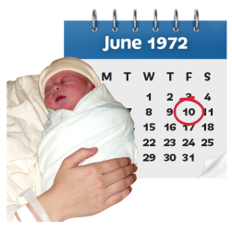
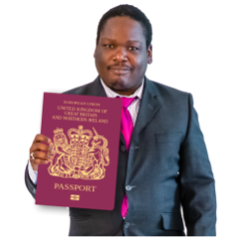
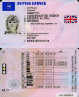
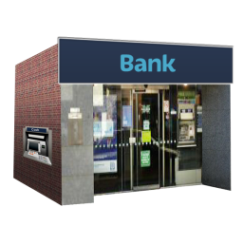
Your first registration with the police
The first time you register with the police you need to tell them your:
Name
Date of birth
Home address
Passport or drivers licence information
Bank details

Slide 11
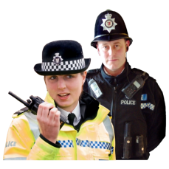
What changes the police need to know
The police need to know of any changes to your information.
This must be done within 3 days.
You must tell the police of a change of address, if staying for more than 7 days.
You must tell the police if you want to travel or go on holiday.

Slide 12
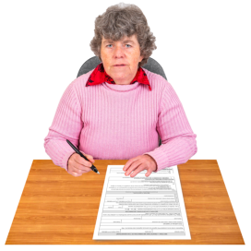
Indefinite notifications
An indefinite notification is when you have to register with the police for at least 15 years.
Some people convicted of sexual offences have indefinite notifications.
After 15 years you have to apply to have this stopped.
Your designated risk manager can help you with this.

Slide 13
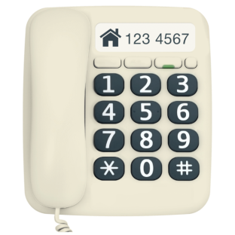
Further information
For more information you can look up:
www.publicprotectionni.com
Your key person to contact is:
____________________________________________________________________________________________________________________________________________________________________________________
Created in collaboration with the Northern HSC Trust Promote (Learning Disability) Team.

